Slide 1
Arithmetic logic unit (ALU)
01
Name : Sathy Akter
ID: 18101077

Slide 2
02
Content
What is ALU?
Introducing to Arithmetic Unit and Logical Unit.
How does occur Binary Addition.
How does occur Binary Subtraction.
Circuit Diagram for ALU.
Describing about Code.

Slide 3
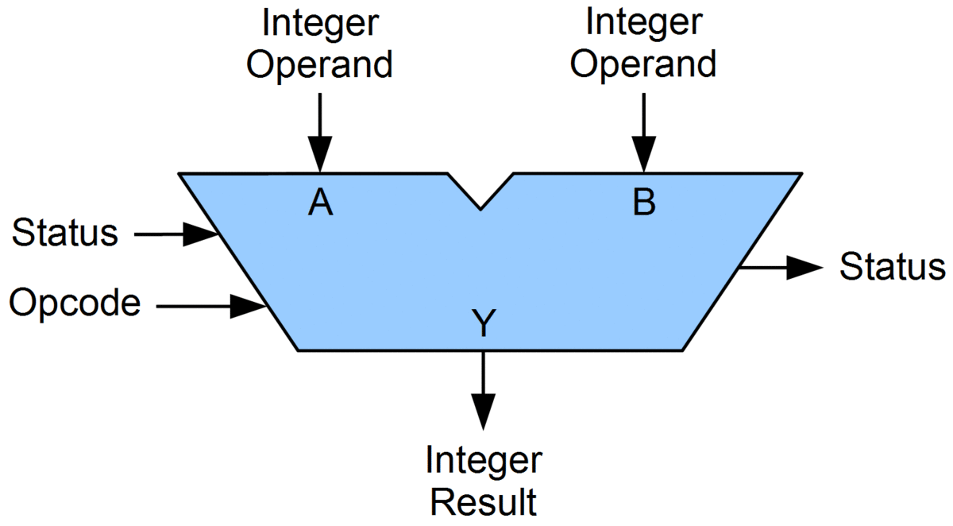
03
Definition of ALU
In computing, an arithmetic logic unit is a combinational digital circuit that performs arithmetic and bitwise operations on integer binary numbers. This is in contrast to a floating-point unit, which operates on floating point numbers.
Fig: ALU
Image Source: www.google.com

Slide 4
04
What is the basic use of ALU unit?
An arithmetic logic unit (ALU), a memory unit, and input/output (I/O) controllers. The ALU performs simple addition, subtraction, multiplication, division, and logic operations, such as OR and AND. The memory stores the program's instructions and data.

Slide 5
05
ALU(Arithmetic Logic Unit)
AU(Arithmetic Unint)
LU(Logical Unint)
A+B
A-B
A+1
A-1
AND
OR
NOT
XOR

Slide 6
06
Let’s make 2 bit ALU with Arduino.

Slide 7
07
Binary ADD:
Cin = 1 0 1 1 1 1 0 A = 1 1 0 1 1 0 1 1 (219)
+ B = 1 1 0 0 0 1 1 0 (198)
1 1 0 1 0 0 0 0 1 (417)

Slide 8
08
Binary ADD:
0
For Add operation
Cin = 1 0 1 1 1 1 0 A = 1 1 0 1 1 0 1 1 (219)
+ B = 1 1 0 0 0 1 1 0 (198)
1 1 0 1 0 0 0 0 1 (417)

Slide 9
09
Binary addition bit combination:
0 0 0
0 0
Cin
2. 0 0 1
0 1
Cin
3. 0 1 1
1 0
Cin
4. 1 1 1
1 1
Cin
A
A
A
A
B
B
B
B
Carry
Sum
Carry
Carry
Sum
Carry
Sum
Sum

Slide 10
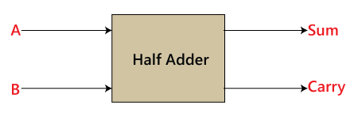
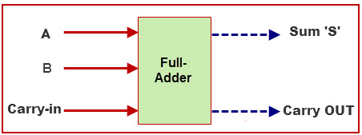
10
A1
Sum1
A0
Sum0
B1
Full-Adder
B0
Full-Adder
Cout
Cin
Cout
Cin
Fig: 2 bit addition
Image Source: www.google.com

Slide 11
11
Binary Subtraction:
A = 1 1 0 1 1 0 1 1 (219)
B = 1 1 0 0 0 1 1 0 (198)
B = 0 0 1 1 1 0 0 1 [1's complement]
+ 1
B’= 0 0 1 1 1 0 1 0 [2's complement]
0
For Add operation
Cin = 1 1 1 1 0 1 0 A = 1 1 0 1 1 0 1 1 (219)
+ B’ = 0 0 1 1 1 0 1 0 (198)
1 0 0 0 1 0 1 0 1 (21)

Slide 12
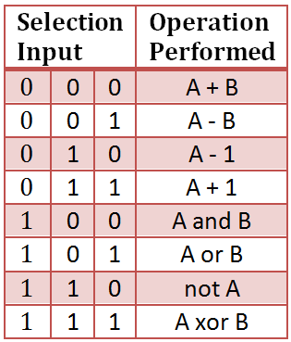
12
ALU Truth Table:
Image Source: www.google.com

Slide 13
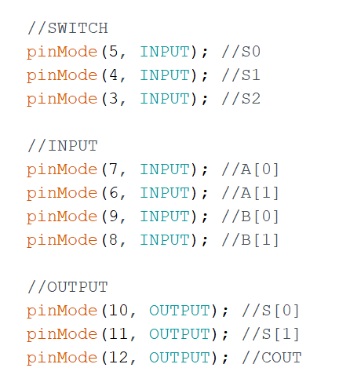
13
Arduino Input, Output Pin number:

Slide 14
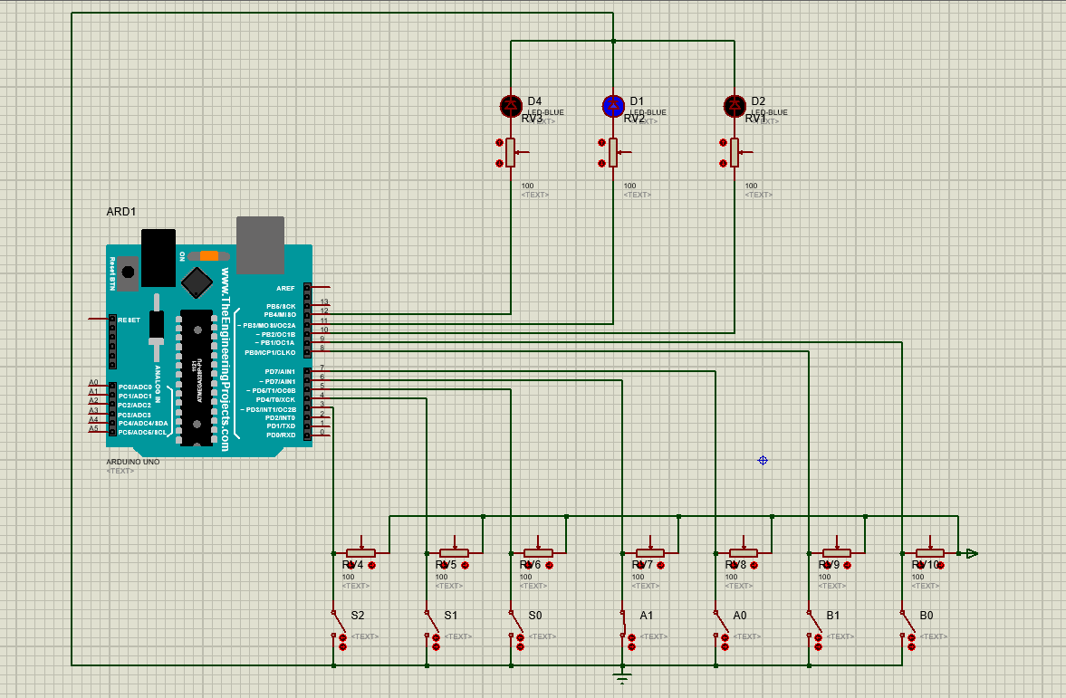
14
Circuit implementation using Proteus:

Slide 15
15
Functions I made for make 2 bit ALU.

Slide 16
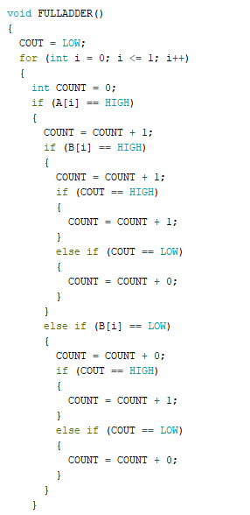
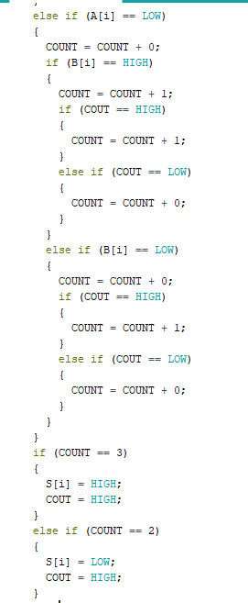
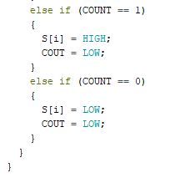
16

Slide 17
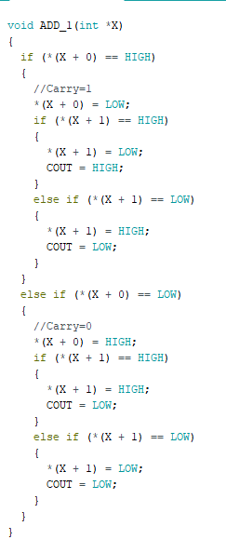
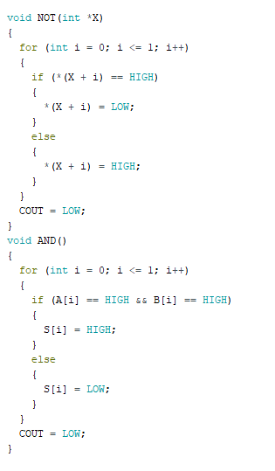
17

Slide 18
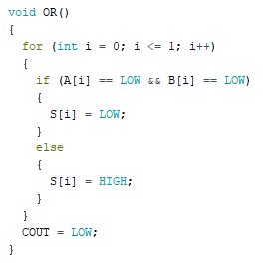
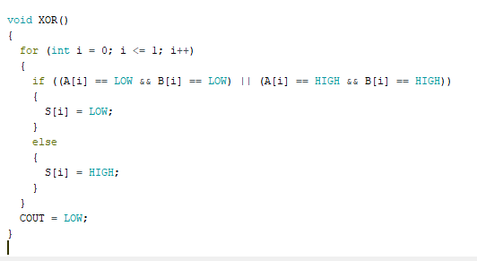
18

Slide 19


19
Increment(A+1)
Let’s assume A=10 (2)
And B=1 (1) Or we can represent it as B=01 (1)
1 0 (A)
0 1 (B)
0 1 1
Okay I am done, here is your result
Calling Fulladder
0 1 1
Image Source: www.google.com

Slide 20
20
Decrement(A-1)
Let’s assume A=10 (1)
And B=1 Or we can represent it as B=01 After 1’s complement B’=10 After 2’s complement B’’=11
1 0
1 1
1 0 1
Okay I am done, here is your result
Calling Fulladder
1 0 1
Image Source: www.google.com

Slide 21

21
Thank You
Image Source: www.google.com
YouTube Link: https://youtu.be/BpUZlvESnmw

